Slide 1
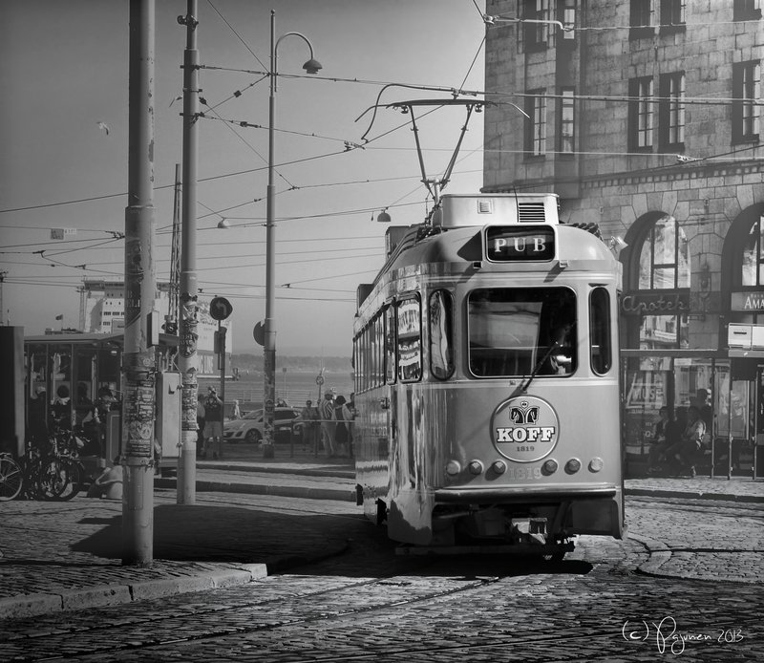
A PRESENTATION ON
PUBLIC TRANSPORT IN PARIS

Slide 2
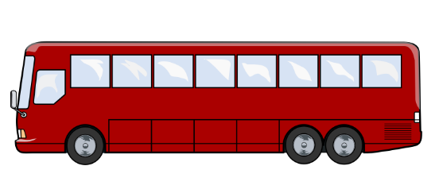
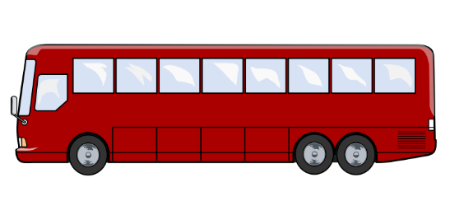
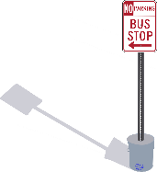




What is Public Transport ???
Buses, trains, subways, and other forms of transportation that charge set fares, run on fixed routes, and are available to the public.

Slide 3

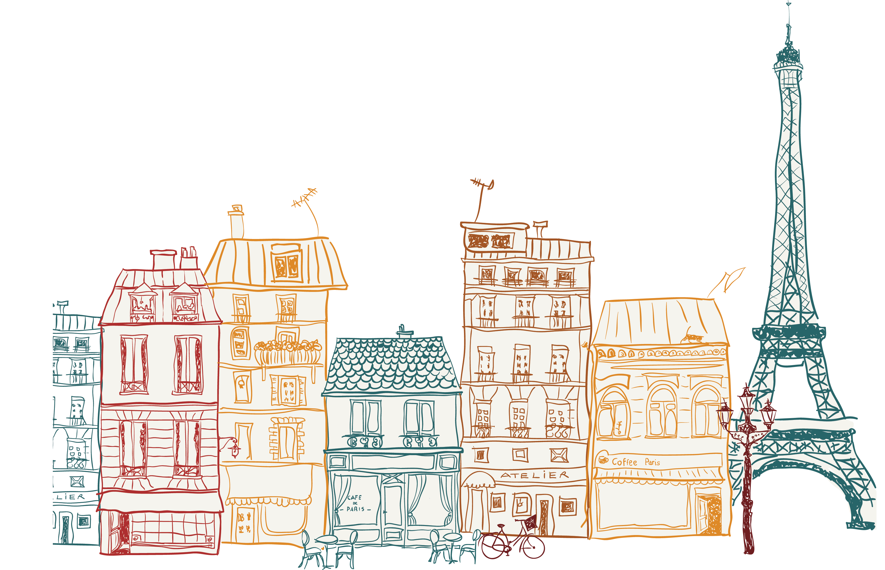


PARIS

Slide 4
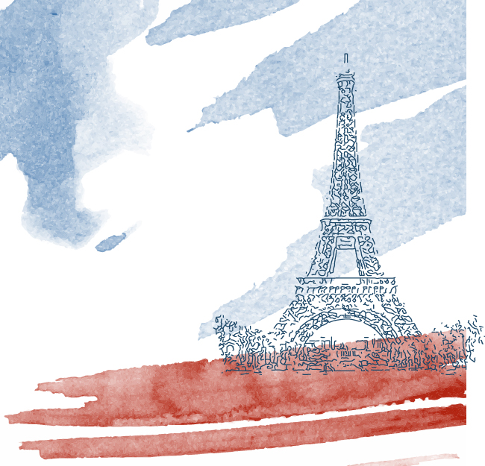




About Paris
FIFTH LARGEST MUNICIPALITY IN THE EUROPEAN UNION
390,480 different types of ENTERPRISES
MOST POPULOUS CITY OF FRANCE
AVG 22.2 MILLION VISITORS PER YEAR

Slide 5
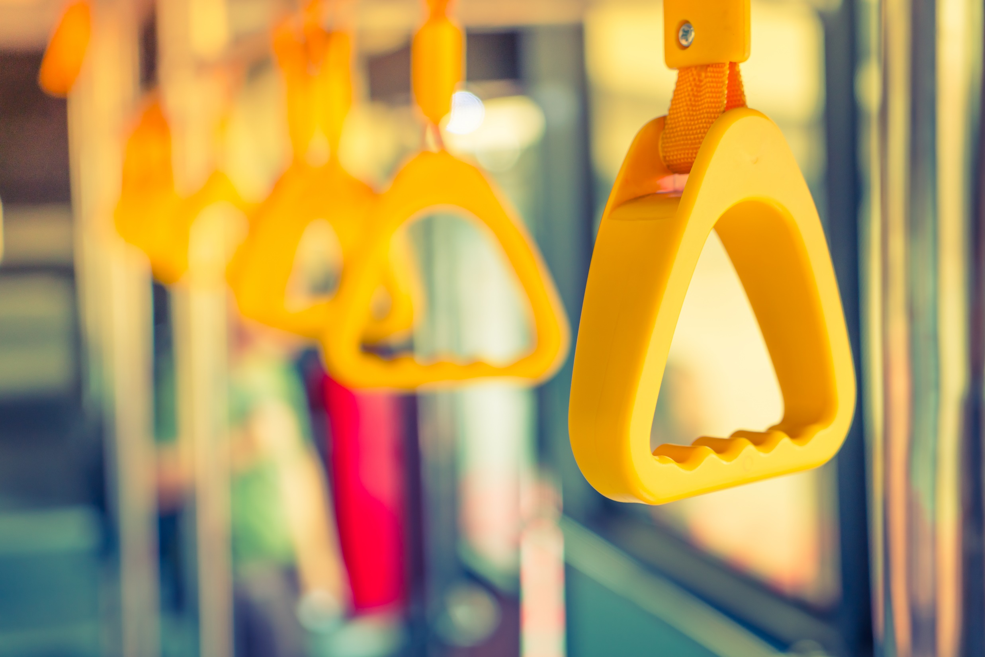
Public Transport and Paris
Paris is by public transport. It has the Metro underground subway system, a tramway, buses and night bus (noctilien) and river Batôbus. Plus the RER regional train service that extends to the suburbs and the Ile de France.

Slide 6
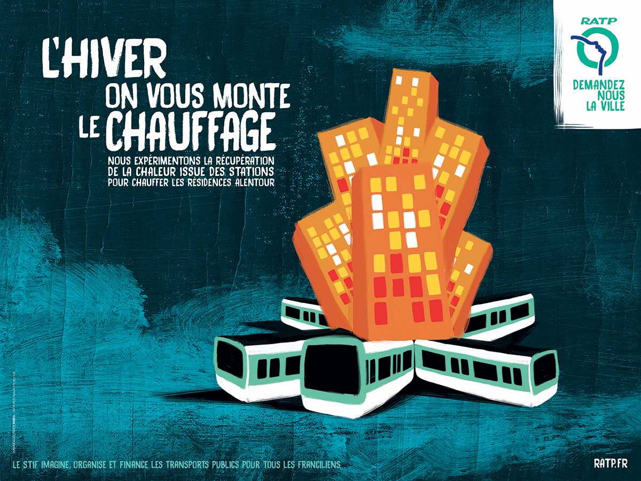

What is R A T P
RATP is the public transport authority for Paris. It operates the Metro (subway) lines ,the RER suburban express railway (lines A, B, C, D and E), the Noctilien (night buses), Orlyval airport rail connections, the Tramway.

Slide 7
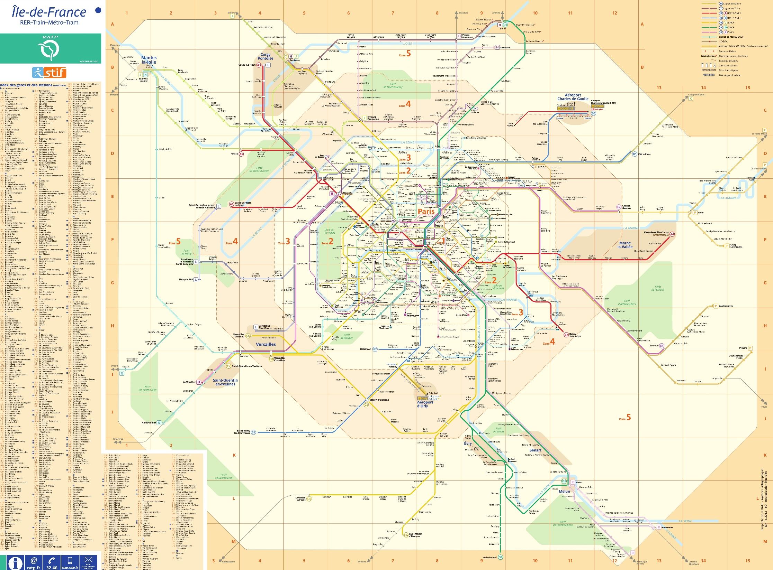
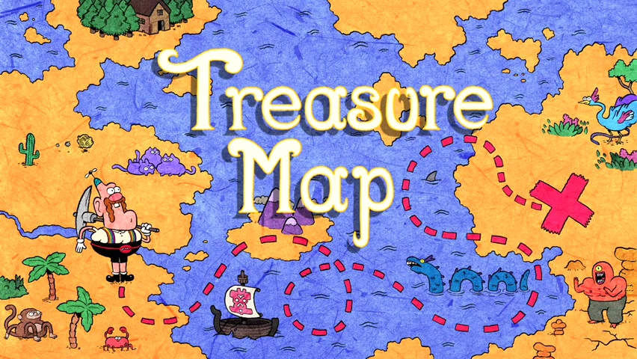
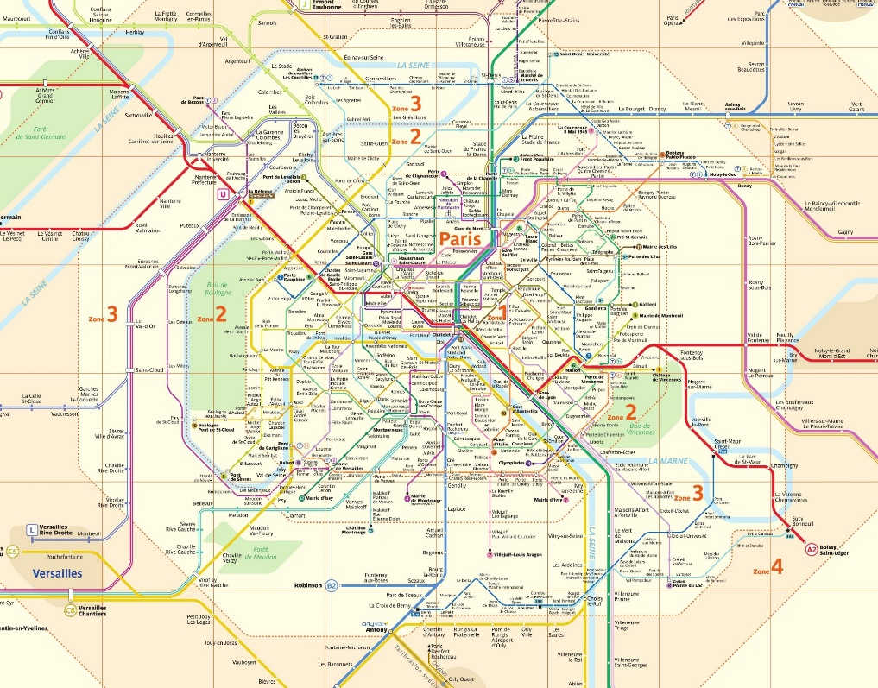
RATP map
The RATP Group Formed in 1948, the group has its origins as the public transport operator for the city of Paris

Slide 8
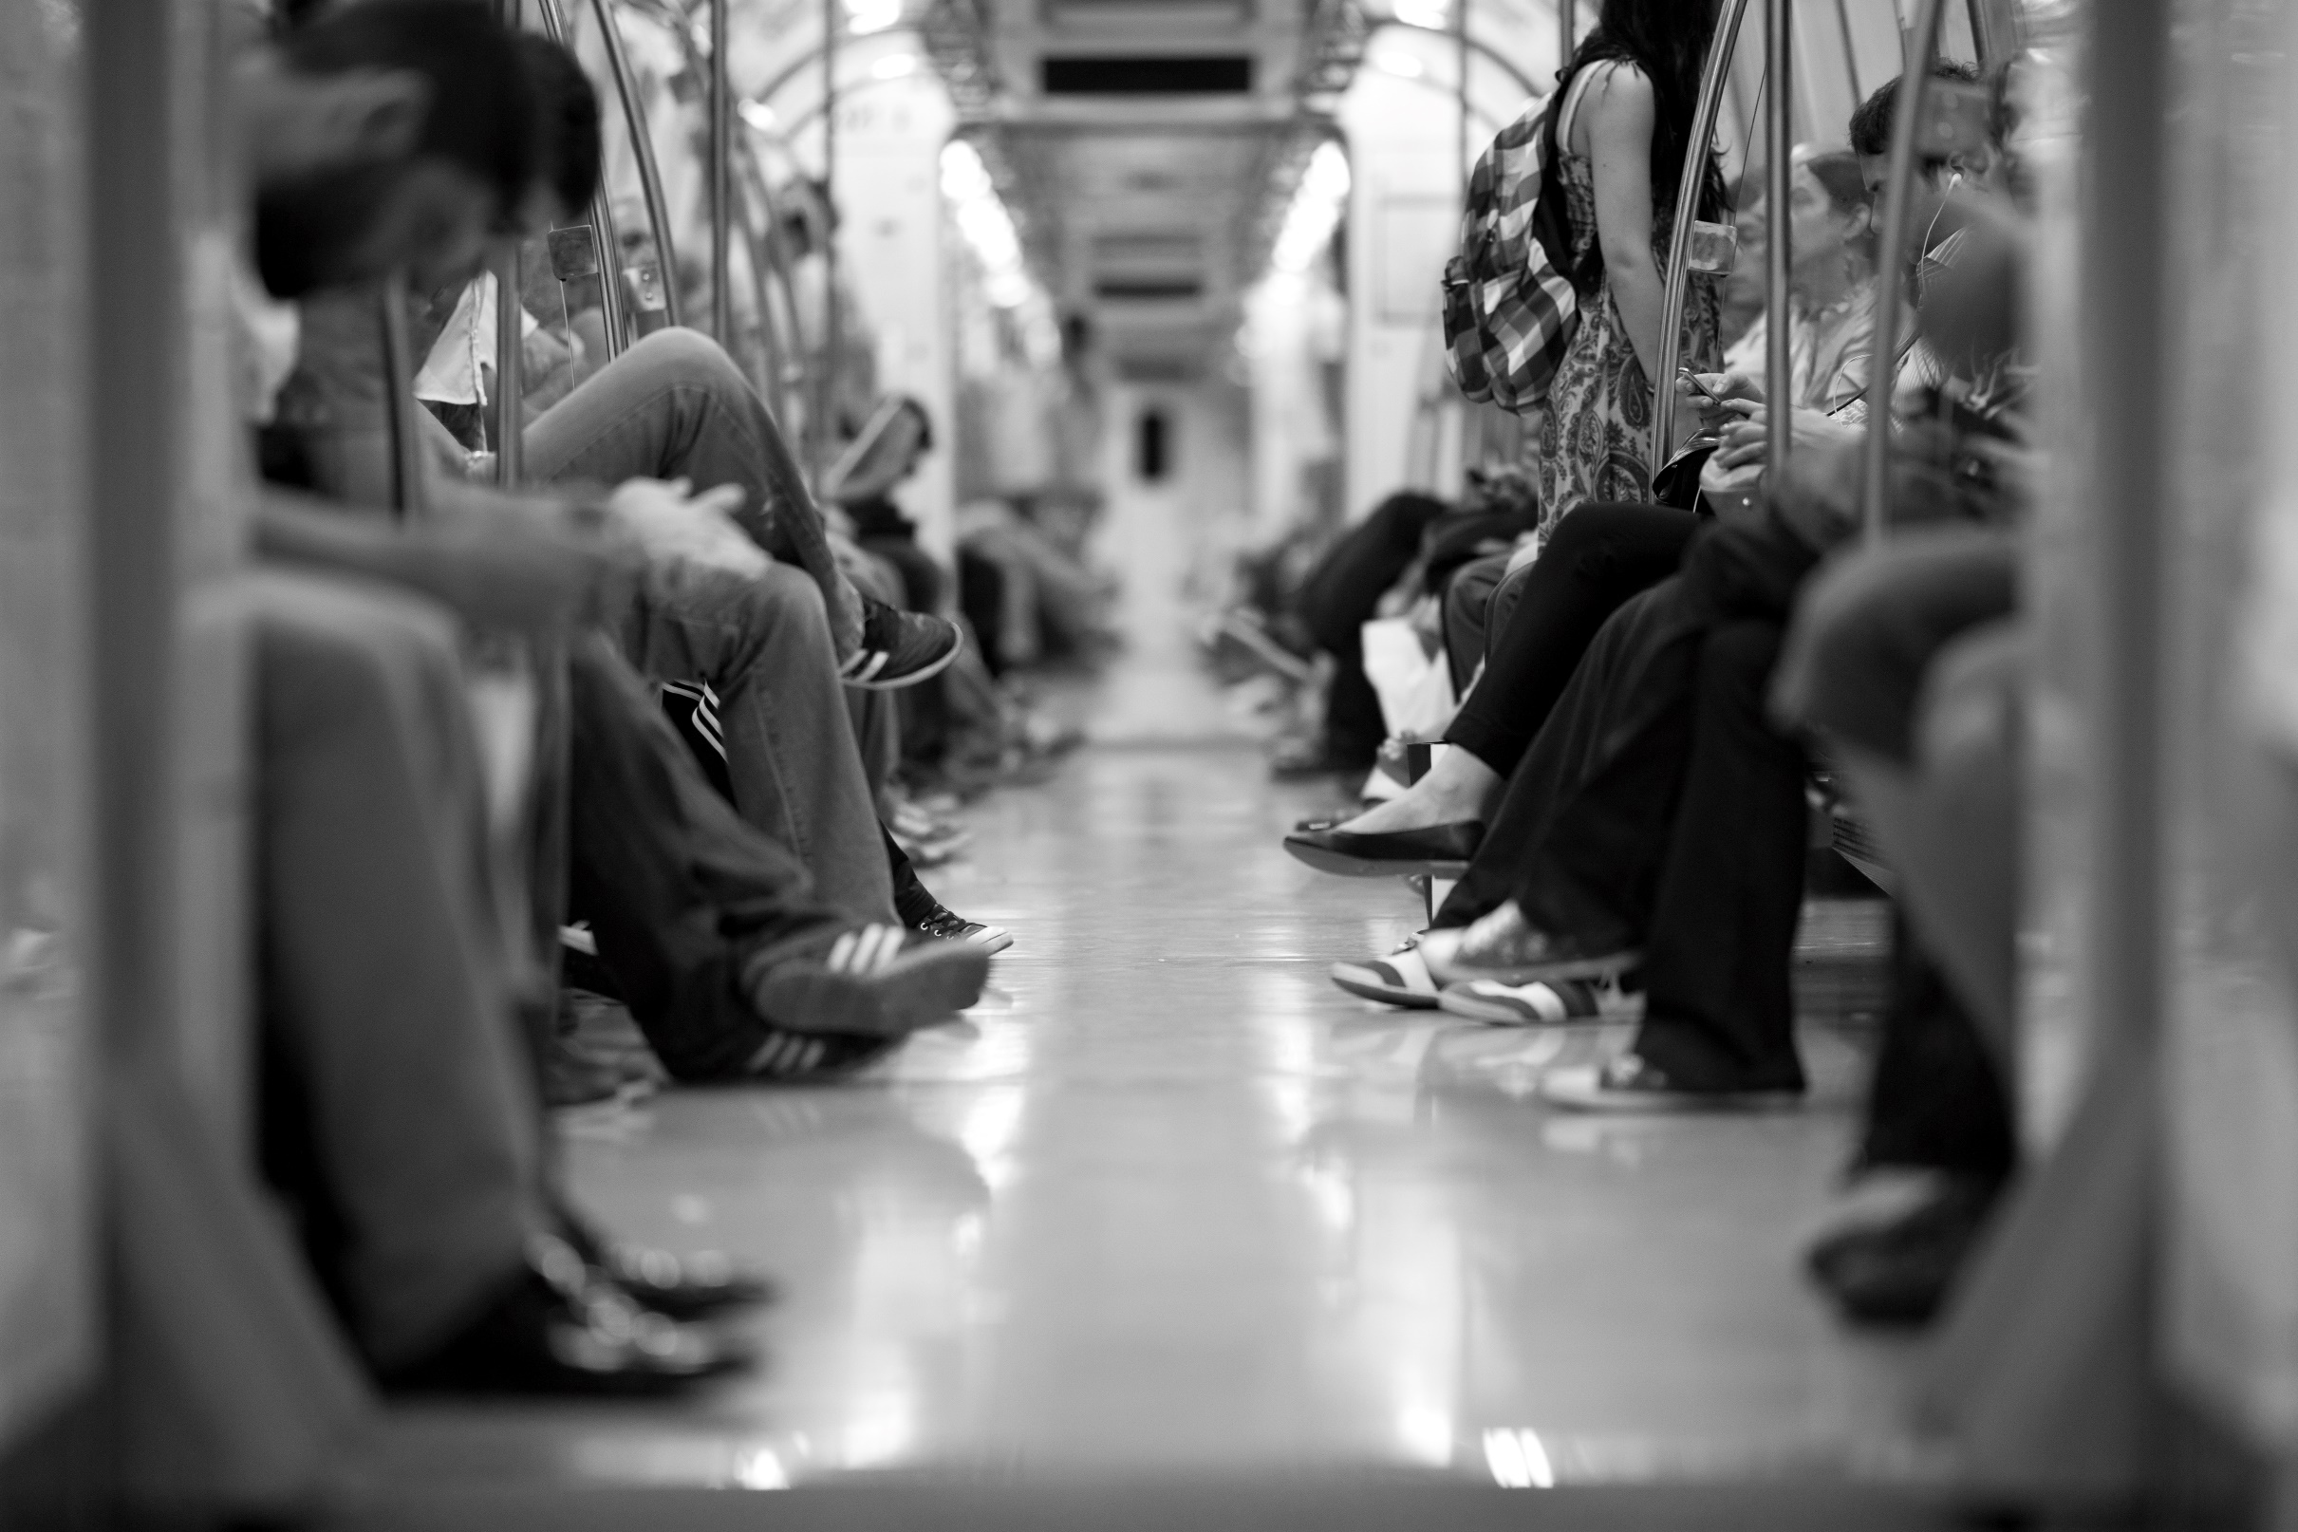
Paris Metro
1│
The Paris Metro is a rapid transit system in the Paris Metropolitan Area.
Paris Metro
2│
300 stations including 16 line
3│
1.5 billion riders in 2013-14.
4│
Average 2 $ for a single ride.
5│
Child under age 4 needs no travel fee.
6│
133 miles of tracks.

Slide 9
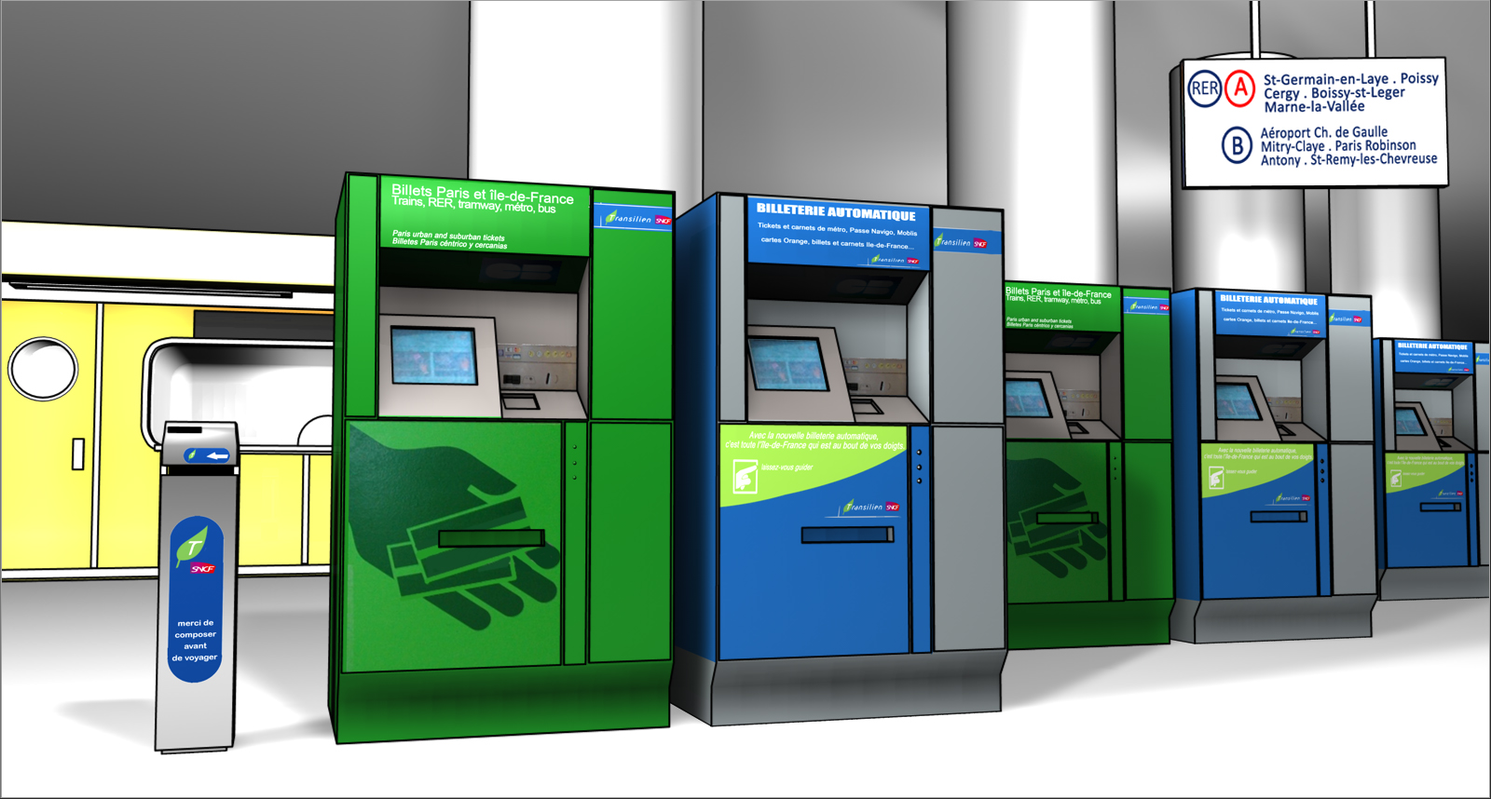

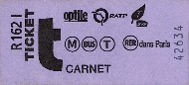
Tickets
Ticket t+
1│
The basic Métro ticket is a small piece of cardboard. Also known as ticket t+.
2│
With a magnetic strip that costs €1,90, It's issued by RATP.
3│
Carnet of 10 tickets are also purchased to save money (€14,50).
4│
Several vending machines to buy ticket t+

Slide 10
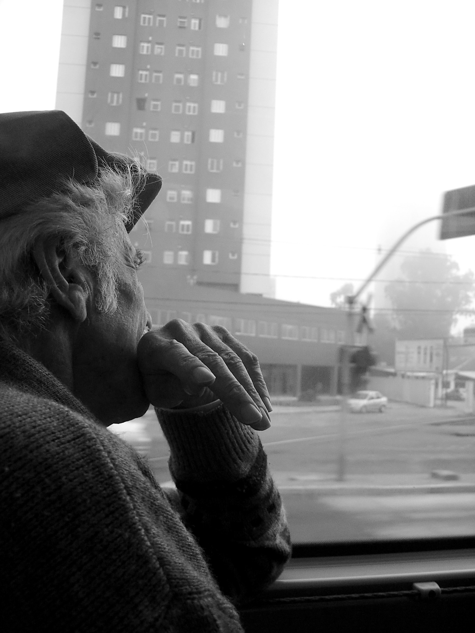
BUS
The RATP operates the majority of buses in Paris and a significant number of lines in its suburbs.
1│
BUS
There are approximately 4,000 buses serving the Paris region.
2│
3│
Buses run from approximately 07:00-20:00.
A single ticket is required to ride most bus lines. An additional ticket is required for each transfer.
4│

Slide 11
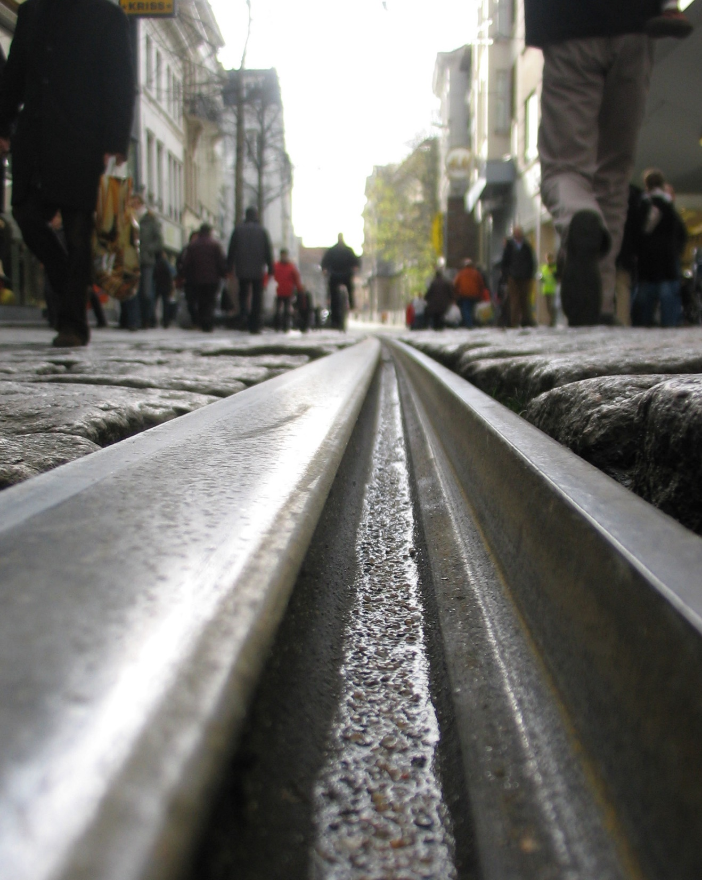
From 1855 to 1938, Paris was served by an extensive tramway network.
Tramways
1│
2│
Nine lines are currently operational.
3│
Although the system mainly runs in the suburban regions of Paris.

Slide 12
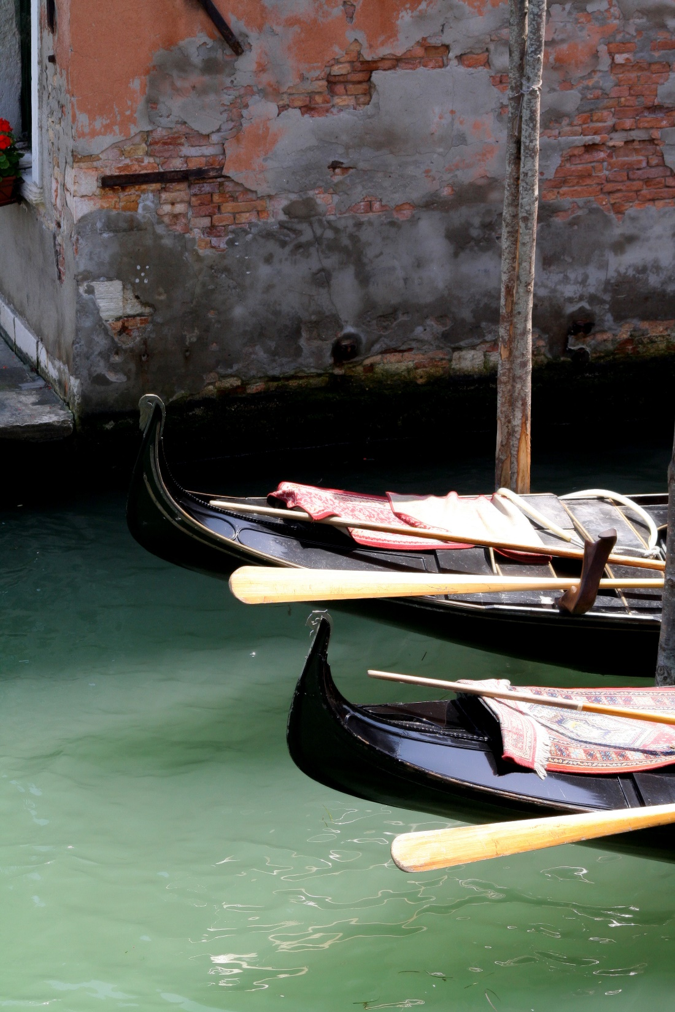
Water Taxi
A water taxi service is operated on the River Seine and the River Marne in the France
1│
Until 1828 passenger river traffic was the only mode of public transport in the France.
2│
3│
Boats leave every 15 to 20 minutes.
4│
It Stops include the Eiffel Tower, Louvre, Notre-Dame etc.

Slide 13
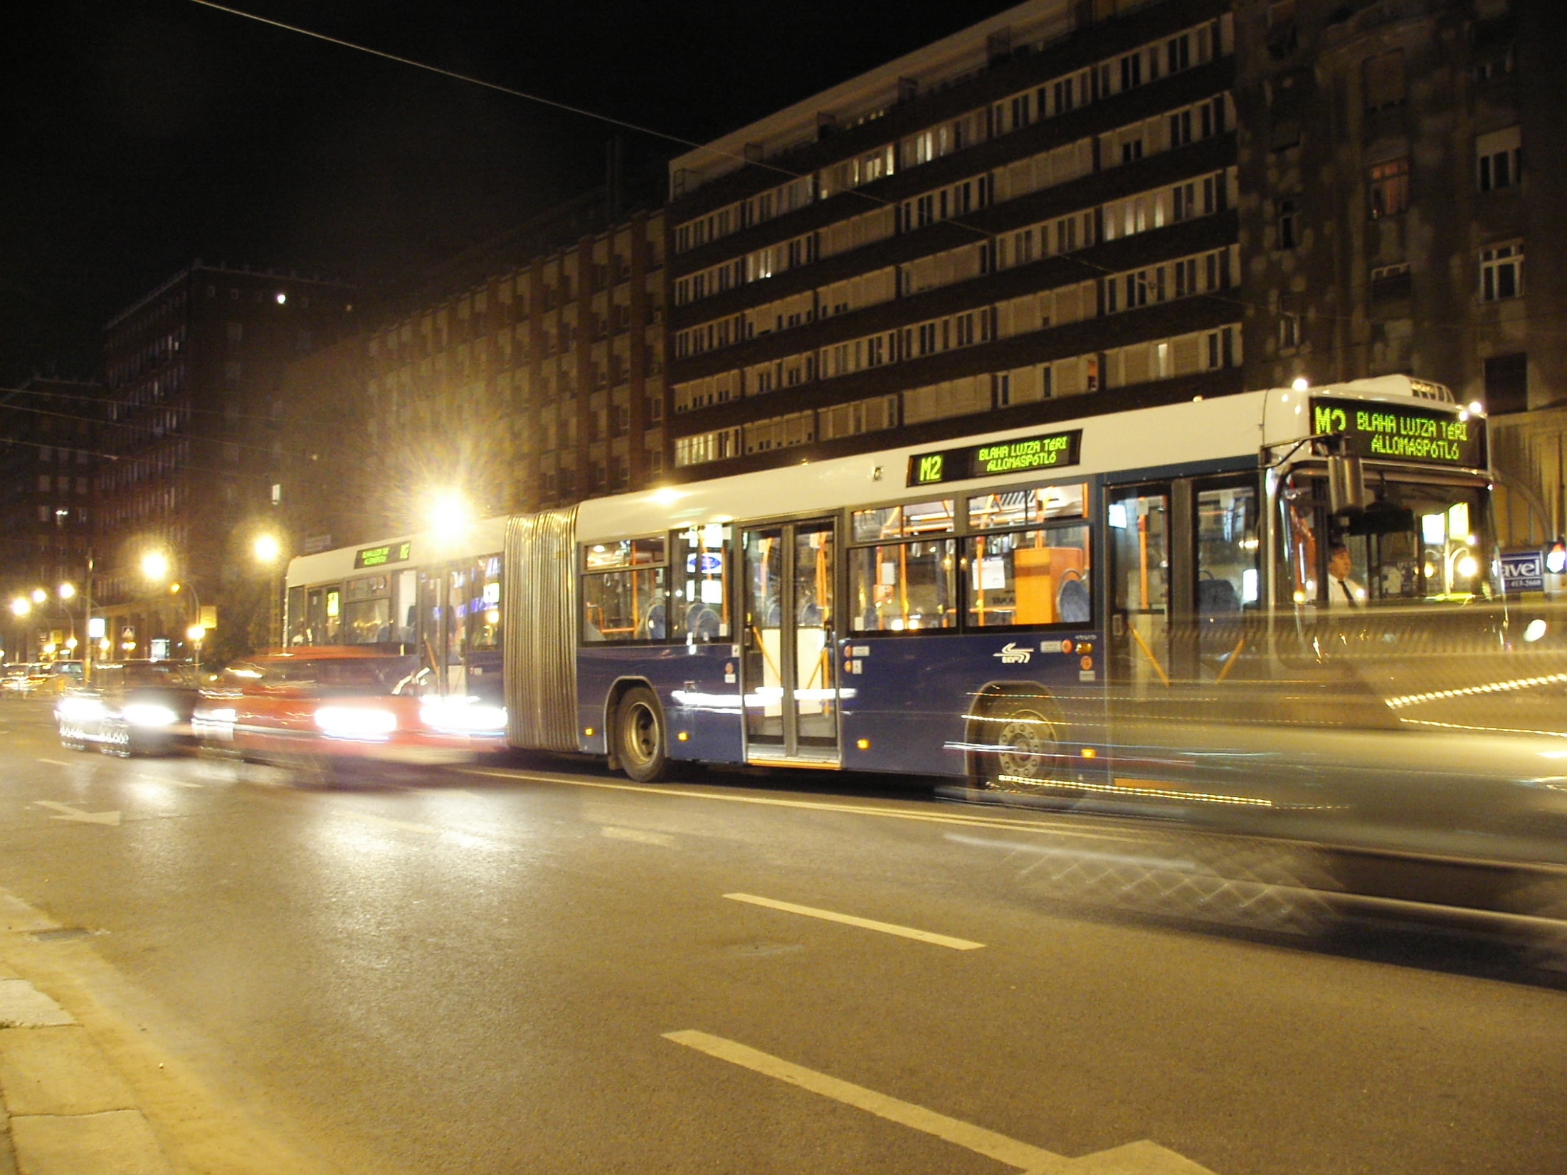
Night Bus
1│
Noctilien is the night bus service in Paris and its agglomeration
2│
Runs from 00:30-05:00
3│
It runs in 42 lines throughout France.

Slide 14




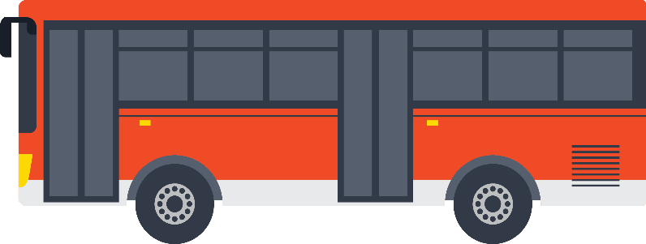



Thank You

